Slide 1
Shiny Workshop Day 1
August 27, 2019
TEA Analytics

Slide 2
Environment Settings

Slide 3
To-Do List
Check the installation of needed apps
R
Rstudio
Download zipped files and save it at Desktop
https://github.com/TEA-Analytics/ShinyWorkshop/releases
Install packages
01_InstallPackages.r
Get cheatsheet.

Slide 4
Disclaimer
This workshop is designed solely with Eina’s biases and skewed personal experiences dealing with r and rshiny.
Eina does not claim the latest knowledge in r shiny, nor the current best practices.
Please know that R community has been evolving rapidly, Eina – who started R coding before tidyverse era – is a bit old-fashioned, and this does not mean Eina is discouraging anybody from adopting the latest trend in R.

Slide 5
Shiny Basics Review

Slide 6


UI and Server
Server
UI
Give me this.
Here it is.
I know how to compute.
I know how to display.
“UI” specifies layout of the app and requests things to a server when needed.
“Server” gives requested whatever (plot, table, …).
Both UI and server are within R.

Slide 7
Server and Shiny-Server
“Server” may refer to the server section of the app.
“Shiny Server” may mean an actual web server that hosts shiny apps.
Topics of deployment will be covered tomorrow.
You have to know the context for knowing which one means.

Slide 8
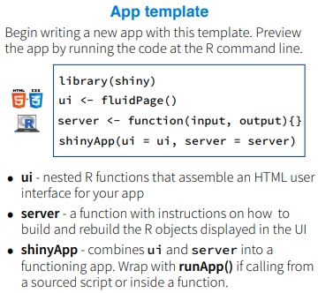
File structures
Many examples online will have everything in one script using shinyApp().
For a small app, it’s easy to see.
Our default file structure is to break it down to 3 (or more) files:
Ui.r
Server.r
Global.r (Optional)
All these 3 files needs to be in a same folder.
runApp(‘foldername’)

Slide 9
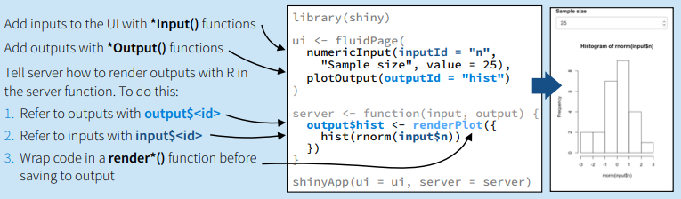
Input() / Render()
Input$xxx
Output$xxx

Slide 10
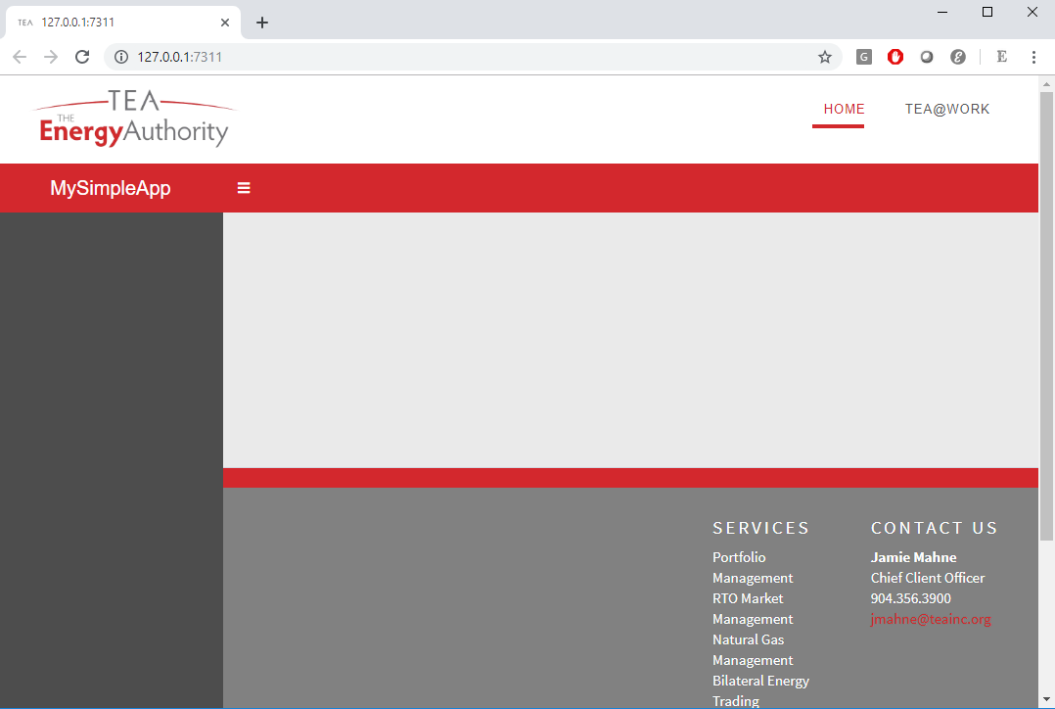
‘teadashboard’ TEA-version of ‘shinydashboard’
In general, we recommend using the ‘teadashboard.’
All functionalities are the same with shinydashboard.
Open “TheSimplest” template and run it.
The RunApp button.

Slide 11
Exercise 1
Do
Run the simplest template.
Break it down to 3 files.
Create a app folder.
Ui.r, server.r, and global.r.
Add the following:
Read in data
Add a section (menuitem)
Add a variable selector
Add a time series plot.
Add a table.
Hints
Read.csv
menuItem
selectInput
plotOutput/renderPlot
dataTableOutput/renderDataTable

Slide 12
Exercise 2
Make the file dependent on market.
Create a selector for market in the sidebar.
Create a reactive object for data.
Make a dymanic UI.
Get rid of the error during computation.
Hints:
selectInput
Reactive
uiOutput/renderUI
Req

Slide 13
Reactive?
Reactive objects live in reactive environments.
Reactive objects
Input$xxx
Reactive()
reactiveValue

Slide 14
Layout
Always use boxes.
Use fluidRow and columns for dividing the page.
Within the divided section of the page, width is specified over 12.
Height specification optional.
Box (3)
Box (width = 9)
Fluid row
Box (6)
Box(4)
Box (width = 12)
Fluid row
Box(12)
Column (width = 8)
Column (column = 4)

Slide 15
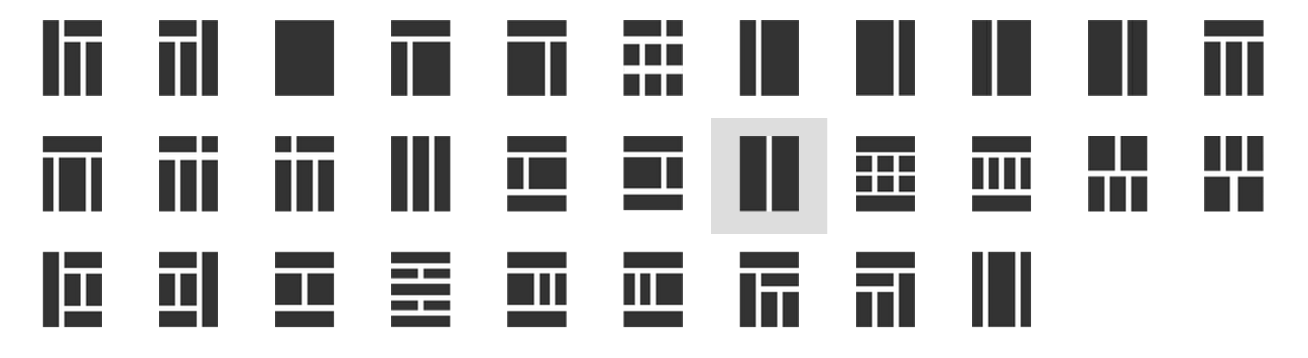
Examples
1
3
2

Slide 16

Exercise 3
Add boxes to the app.
Add anther section (menuitem) and add boxes like this:
Open the ‘TEABranded’ template and notice
A few different layouts
Sidebar submenues
User longin.
“About” page
Check out icons
https://rstudio.github.io/shinydashboard/appearance.html#icons

Slide 17
Tour of TEA Shiny Apps

Slide 18
LMP Forecast
https://analyze.teainc.org/LMP-Forecast-Main/
Notice
Progress Bar
Select Inputs with multiple choices
Interactivity with htmlwidgets
Ability to update data and rerun the model.
Interactive Maps

Slide 19
DeltaHedging
https://analyze.teainc.org/DeltaHedging/
Notice
Excel like look and feel.
Base shiny interactivity
Database connections (read/write)

Slide 20
HedgeFox
https://analyze.teainc.org/HedgeFox/CAISO/
Notice:
Notice subfolder structure
Hide elements by shinyjs.
Use of information boxes.
Rmarkdown reports.

Slide 21
Understanding Reactivity

Slide 22
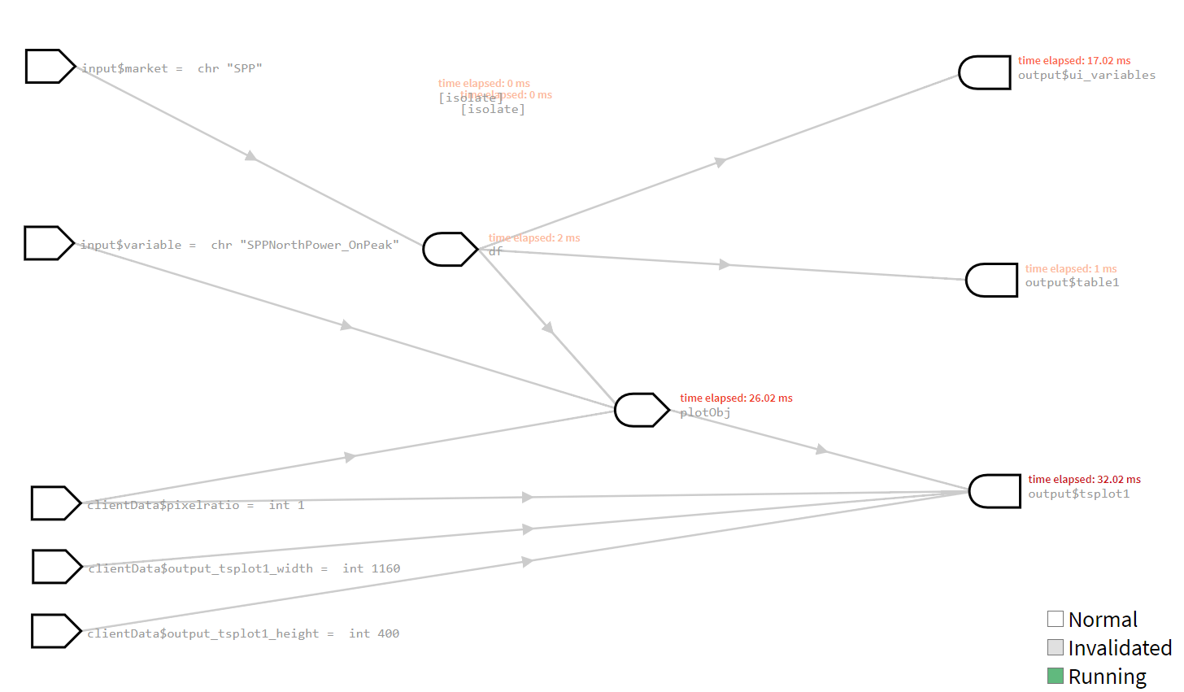
Our First App
Reactive value
Reactive expression
observer

Slide 23
When a Page is Opened
Reactive value
Reactive expression
observer
Follow the arrow backward.

Slide 24
When a Page is Opened
Reactive value
Reactive expression
observer

Slide 25
When Input Changes 1
Reactive value
Reactive expression
observer
Invalidated
Follow the arrow forward.

Slide 26
When Input Changes 1
Reactive value
Reactive expression
observer
Invalidated
If UI requests it, values are re-calculated.

Slide 27
When Input Changes 2
Reactive value
Reactive expression
observer
Invalidated
Invalidated

Slide 28
Demo
options(shiny.reactlog=TRUE)
If TRUE, enable logging of reactive events, which can be viewed later with the showReactLog function. This incurs a substantial performance penalty and should not be used in production.

Slide 29


Objects
R objects
Data frames
arrays
Functions
List
…
Reactive ← Think this like a function
ReactiveValues ← Think this like a list.

Slide 30
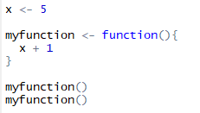


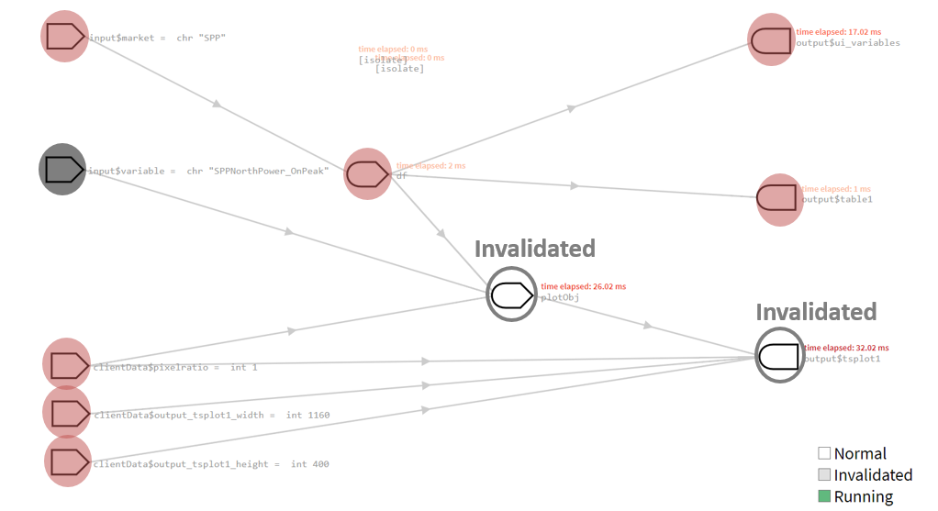
Reactive
Functions
Computes every time it’s called.
Reactive
It caches values.
It knows when inputs change.
It returns cached values if inputs haven’t changed.

Slide 31
Control Reactivity
Req()
Ensure that values are available before proceeding with a calculation or action.
Isolate()
Avoid dependency.
EventReactive()
Specify the dependency.

Slide 32
Excercise
Add update a bottom using EventReactive.

Slide 33
Observe
Observe
observeEvent
Behaviors
Triggered every time one of its inputs changes (regardless of whether values are needed).
Yields no output.
Useful in
Reset input$xxx values using ‘update*Input’ functions.
Display pop-up messages.
Modifying reactiveValues
…

Slide 34
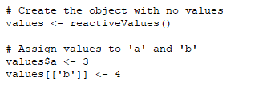
ReactiveValues
ReactiveValue is
Updated and/or called inside
reactive expression or observer.
You need to control when it updates.
No automatic updates when dependencies change.
It can be updated even when outputs are not needed.
Reactive:
You don’t have to worry about dependencies.
Unless manually controlled, it’ll know the dependencies.
It updates only when needed.

Slide 35
Other Use Cases for ReactiveValues
Inputs from multiple sources
Partial data imports.
Append data as needed.
Status flag
Example: https://analyze.teainc.org/DeltaHedging/

Slide 36
Summary on Reactivity
First, think reactive.
Then think req, isolate or eventReactive.
Then think reactiveValues with observe.
More control over dependencies.

Slide 37
When to load data?

Slide 38
Table Choices

Slide 39
Table Choices
Datatable (DT)
Rhandsontable
Formattable
https://renkun-ken.github.io/formattable/

Slide 40
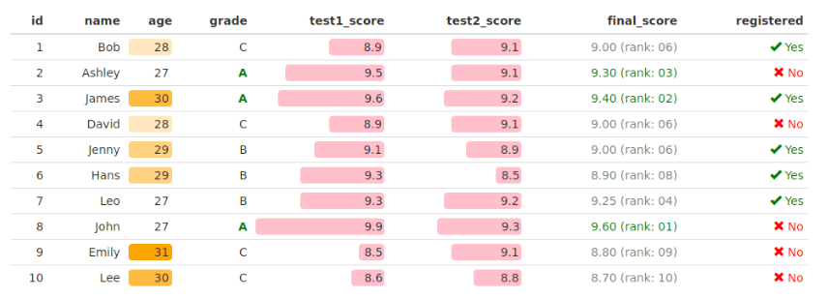
Formattable

Slide 41
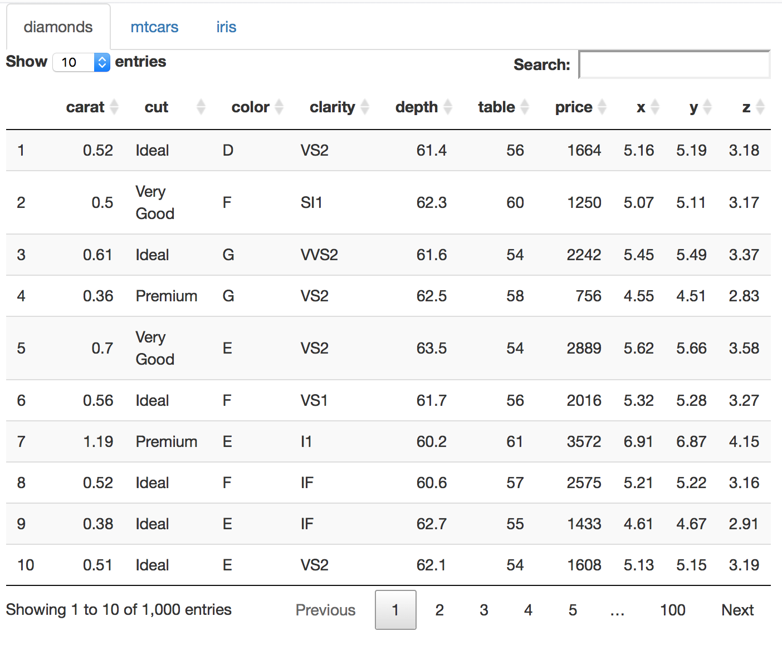
DataTables

Slide 42
Miscellaneous Tips

Slide 43
Progress bars

Slide 44
https://shiny.rstudio.com/gallery/widget-gallery.html
Widget Gallery

Slide 45
https://resources.rstudio.com/shiny-developer-conference/shinydevcon-debugging-jonathanmcpherson-1080p
Debugging

Slide 46
Brekpoints works only within server.
Browser()
conditional
Profvis

Slide 47
Database Connections

Slide 48

Log in info.

Slide 49
Conversation on external (client facing) vs internal.

Slide 50
Git/github

Slide 51
Deployment
Access
Timeout
Default
Making it accessible for external client
Technically how
Concerns/disclaimer.

